Slide 1
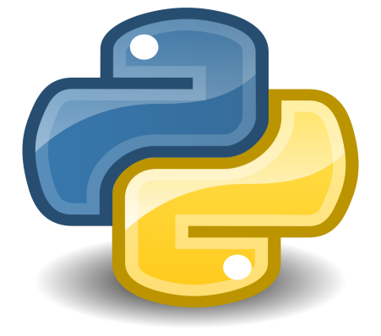
Core Python Course [ Lecture – 1 ]

Slide 2
What is Python?
Python is an elegant & robust programming language that delivers both the power and application of traditional compiled languages with the ease of use of simpler scripting and interpreted languages.
Python was developed by Guido van Rossum in late 1989.
It’s High Level Language
OOP ( Object Oriented Programming )
It is Scalable
Extensible
It’s Portable
It’s Easy To Learn
Robust & Effective
Memory Manager
Interpreted & (Byte) Complied

Slide 3
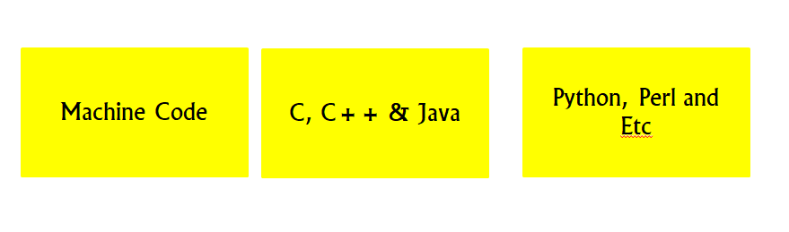
Features:- It’s High Level Language
Python is HLL in other words It enables development of program in user friendly programming context.
Python has it’s own high level built in data structures such as lists ( resizable arrays ), dictionaries ( hash tables ) and lot more which we will study in this course.
Features:- OOP
OOP is a programming model that is totally based on classes and objects, It is used to structure Software program in simple reusable code which is usually a class and then we make a copy of this class which is known as object.
Python is not only OOP Lang. It also has functional programming things borrowed from Haskell and Lisp.

Slide 4
Features:- It is Scalable
Python provides basic building blocks on which you can build an application, and as those needs expand and grow and further they can be easily maintained.
Features:- It is Extensible
You’re working on some project, the amount of logic, files you write or the feature you made, you can still be able to use in just second whether it be in another file.
Features:- It’s Portable
Python can be found on wide variety of systems and it is contributing to large parts in the CS domain.

Slide 5
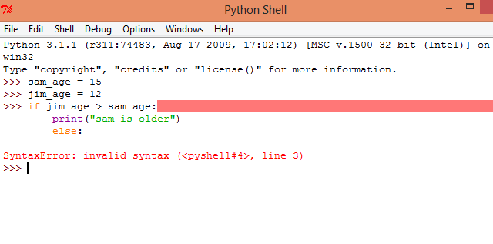
Features:- Robust & Effective
When your Python crashes due to errors, the interpreter dumps out a "stack trace" full of useful information such as why your program crashed and where in the code (file name, line number, function call, etc.) the error took place.
Features:- Memory Manager
It is responsible for:-
Allocation of Memory
Retrieving and Storing the contents
Effective Sharing
Minimizing Memory Access Time

Slide 6
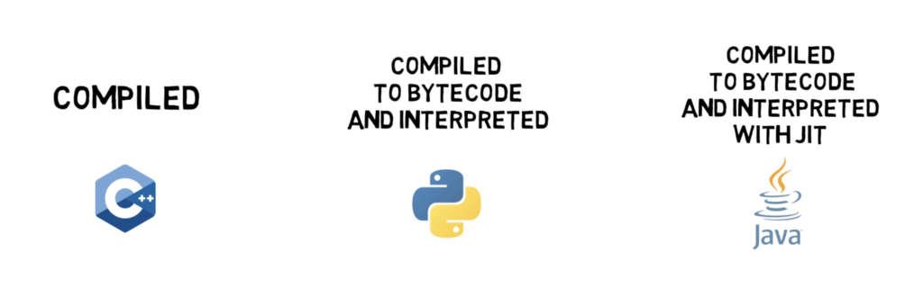
Features:- Interpreted & (Byte) Complied
Python is classified as Interpreted languages, Traditionally, purely interpreted languages are almost always slower than compiled languages because execution does not take place in a system's native binary language.
BUT
Python is byte compiled, it helps in boosting up the performance and having advantages of Interpreted languages.

Slide 7
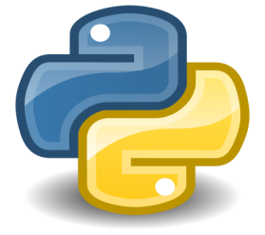
Downloading & Installing

